Slide 1
ML Workshop – Logistic Regression
Durham Artificial Intelligence Society

Slide 2
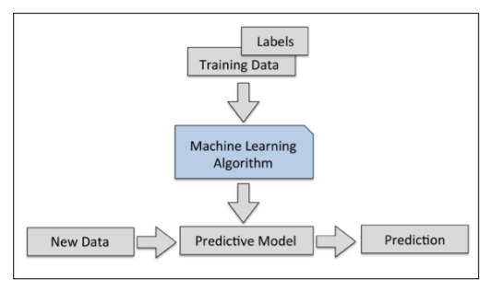
Recap from previous workshop
We introduced Machine Learning and the different kinds of learning – e.g. supervised, unsupervised, reinforced
We looked at the Perceptron algorithm and trained a basic model on this dataset to ‘classify’ flower species

Slide 3
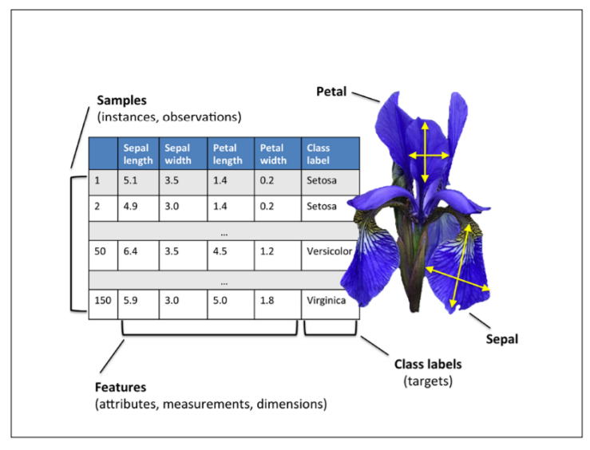
Basic Terminology and Notations
We will begin by using the ‘Iris’ dataset to train our models
This contains measurements of 150 Iris flowers from three different species – Setosa, Versicolor and Virginica
Each sample is on row of the data
The columns are called features

Slide 4
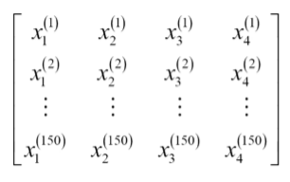
Mathematical Aside – Iris Dataset Features
For the mathematically inclined: we can organise the Iris dataset’s 150 samples into a 150x4 matrix
Henceforth in mathematical asides, we will use the superscript i to refer to the ith training sample and the subscript j to refer to the jth dimension of the training dataset
Do not worry about this if it is new!

Slide 5
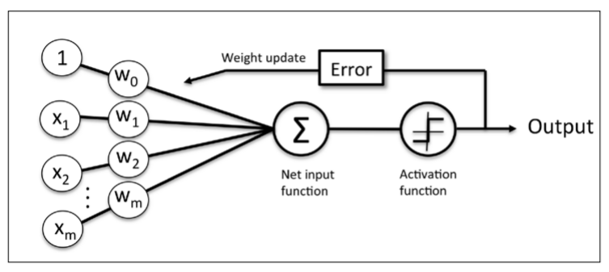
Perceptron Learning Rule
This is the ‘flowchart’ of the Perceptron training model
Features x are multiplied by weights w to give a predicted class value and the weights are updated until the predictions match the known results

Slide 6
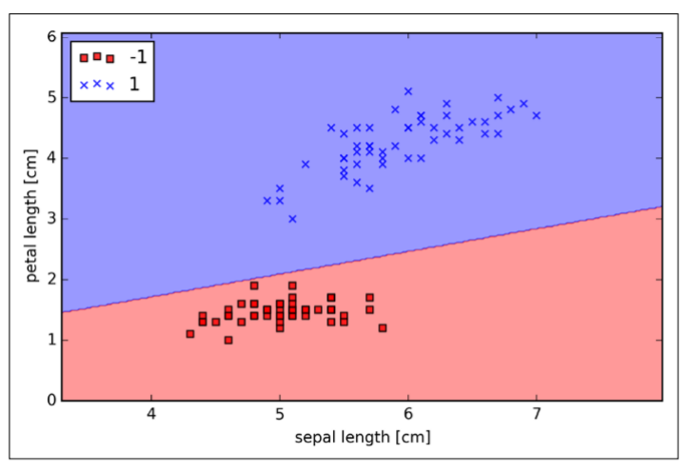
Perceptron Results

Slide 7
Logistic Regression
Just like the Perceptron, it is a classification model that performs very well on linearly separable classes
One of the most widely used algorithms for classification in industry
We can use the same features x multiplied by feature weights w to determine a rule for classifying our data, but we do this in a much more effective (and interesting!) way

Slide 8
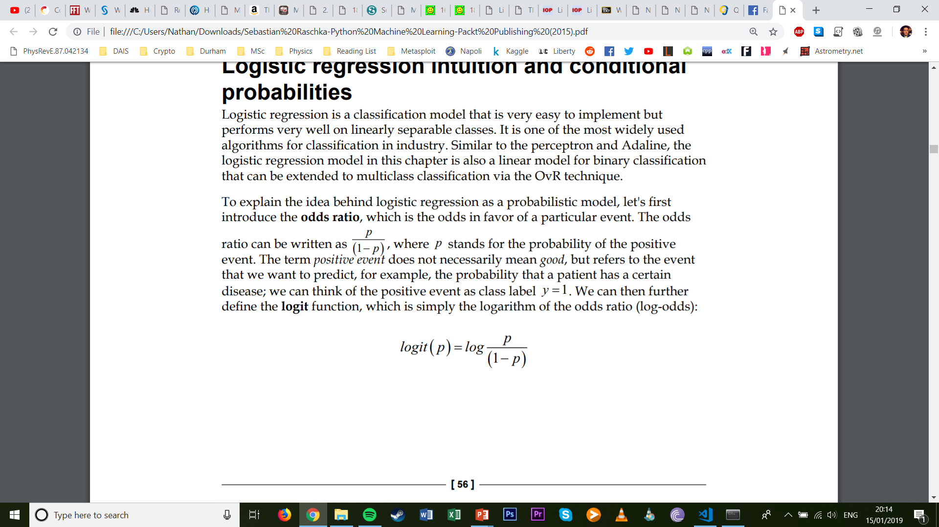
Mathematical Aside – Probabilities
This is the odds ratio: the odds in favour of a particular event, where p is the probability of the positive event
The positive event does not necessarily mean good, but refers to the event we want to predict
If we have the positive class label y = 1, then we define the logit function as

Slide 9
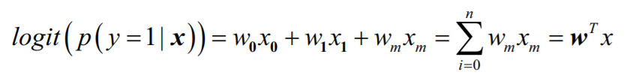
Mathematical Aside - Probabilities
The logit function takes input values in the range 0 to 1 and transforms them to values over the entire real-number range, which we can use to express a linear relationship between features values and the log-odds
Here p(y=1|x) is the conditional probability that a particular sample belongs to a class 1 given its features x

Slide 10
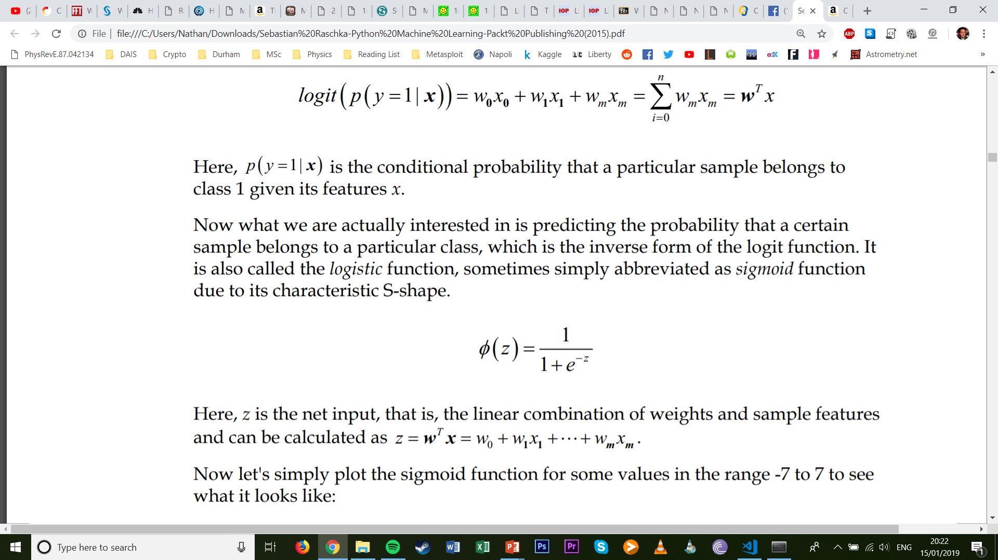
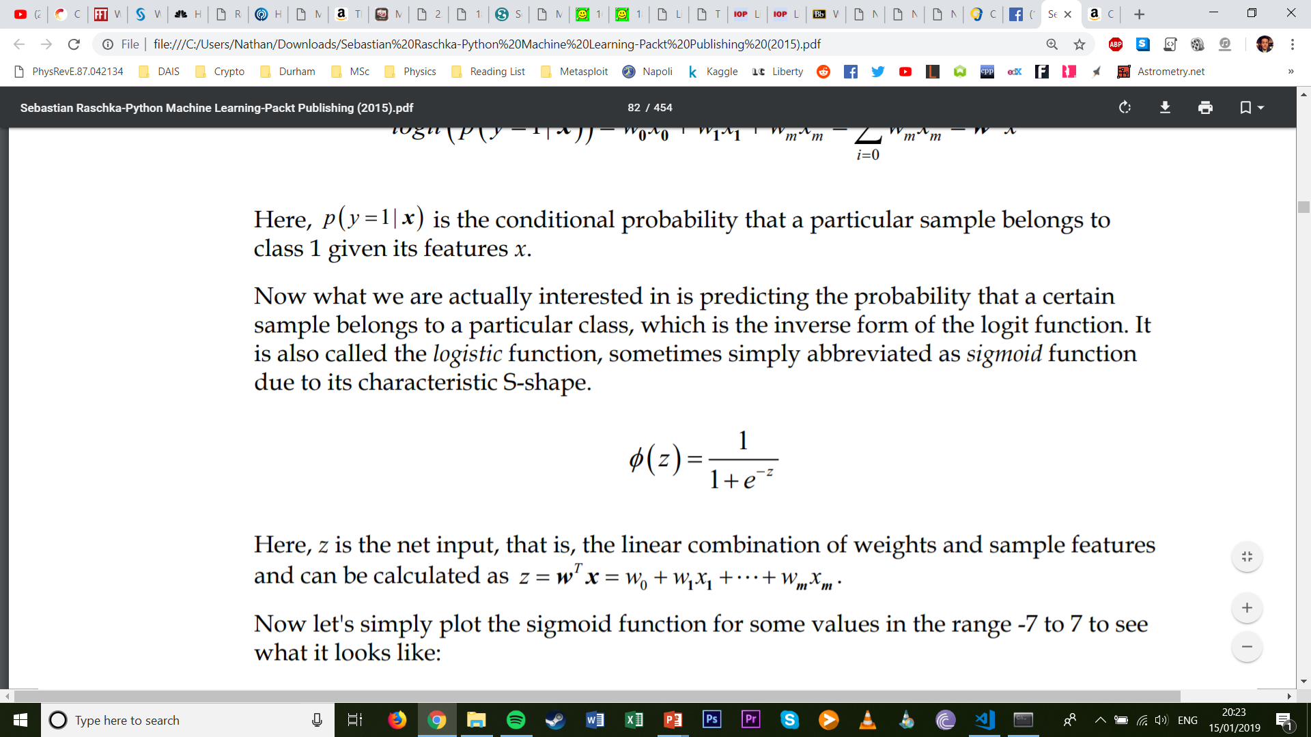
Mathematical Aside - Probabilities
We are actually interested in predicting the probability that a certain sample belongs to a particular class
This is the inverse of the logit function, called the logistic sigmoid function. It is defined by the following:
Here, z is the linear combination of the weight and samples features:

Slide 11
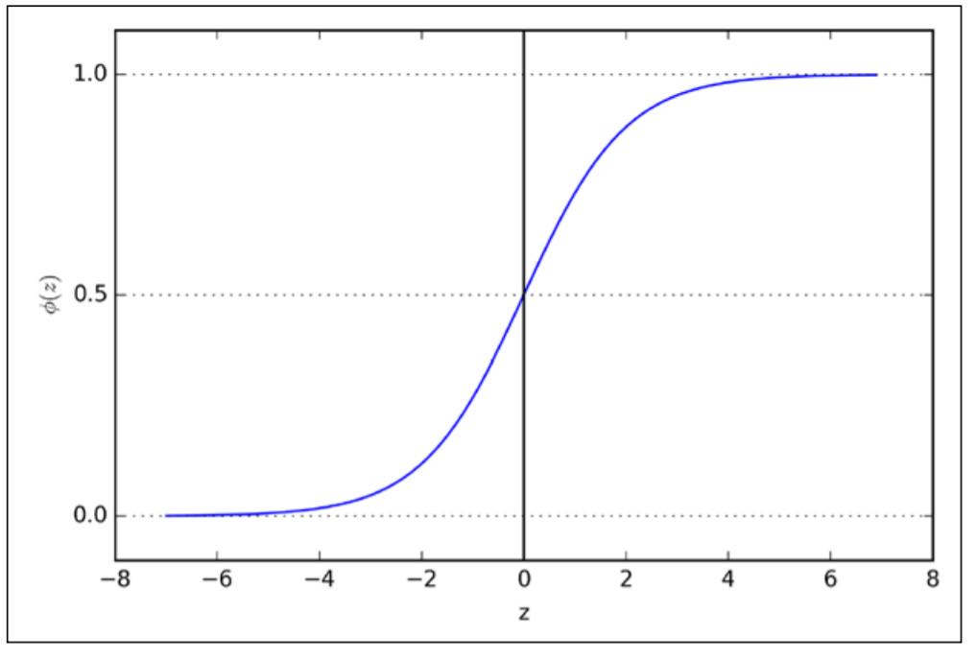
Mathematical Aside - Probabilities

Slide 12
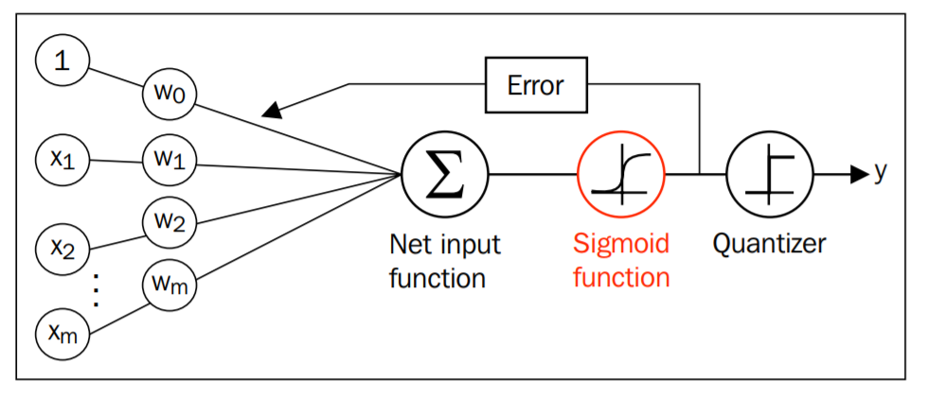
Mathematical Aside - Probabilities
The logistic sigmoid function becomes the activation function
The output of the sigmoid function is then interpreted as the probabilities of a particular sample belonging to class 1
For example, if we compute φ(z) = 0.8 for a particular flower sample, the probability that this sample is an Iris-versicolor flower is 80 percent

Slide 13
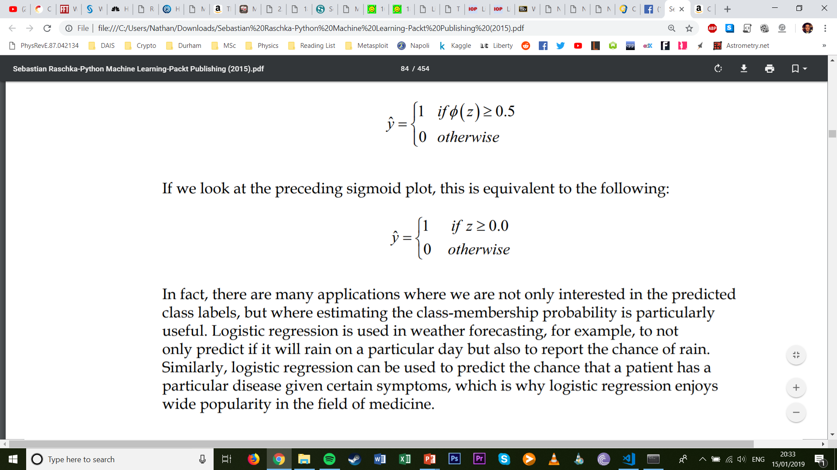
Mathematical Aside - Probabilities
The predicted probability can then simply be converted into a binary outcome via the threshold function
This is equivalent to the following:

Slide 14
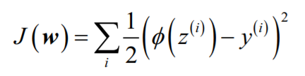
Learning the weights of the logistic cost function
We know how to use the logistic regression model to predict probabilities and class labels
But how do we fit the parameters (weights) of the model?
Let’s define the sum-squared error cost function as follows

Slide 15
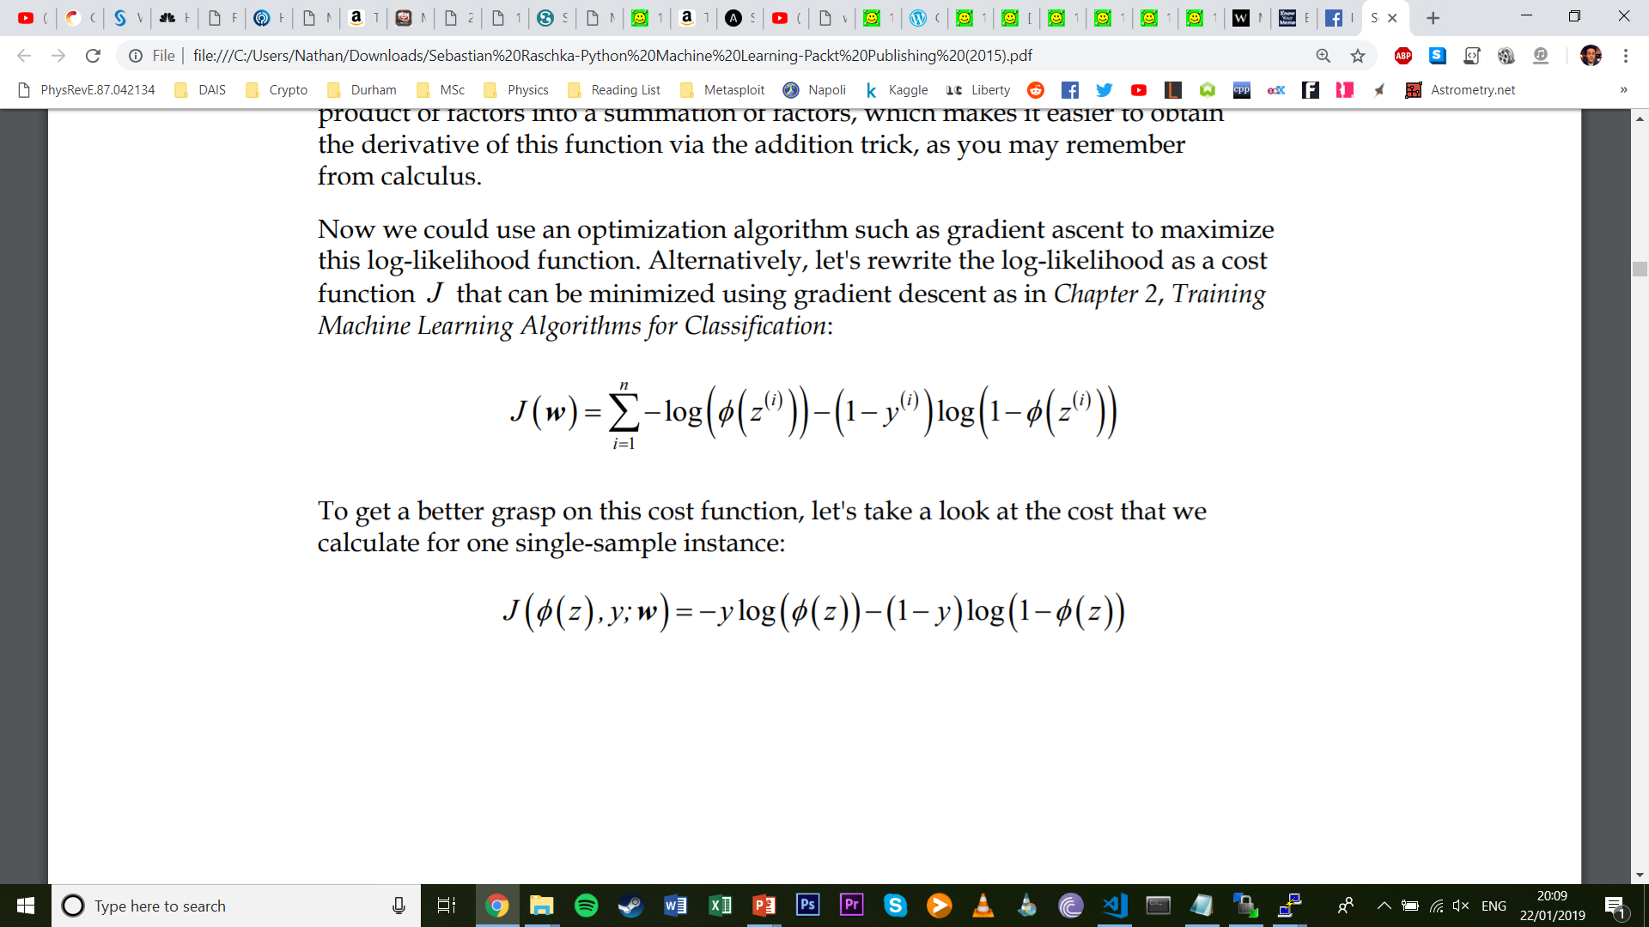
Learning the weights of the logistic cost function
The following cost function can be minimised using gradient descent, and incorporates a log-likelihood function
What is the cost that we calculate for one single-sample training instance?

Slide 16
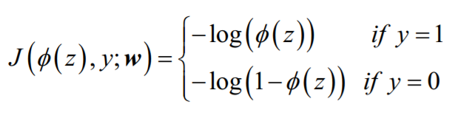
Learning the weights of the logistic cost function
If we look at this equation, we can see that the first term becomes zero is y=0, and the second term becomes zero if y=1

Slide 17
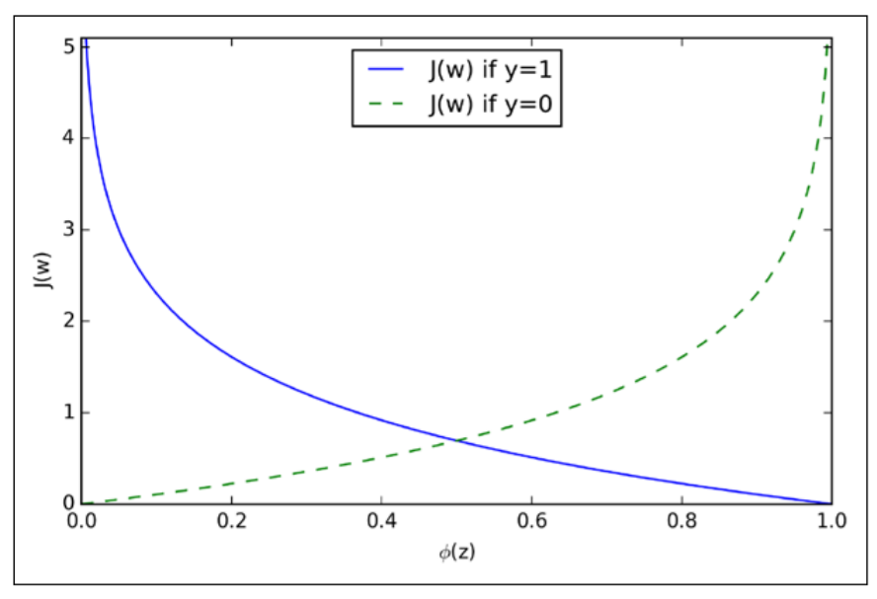
Learning the weights of the logistic cost function
The cost function increasingly penalises incorrect class classification!

Slide 18
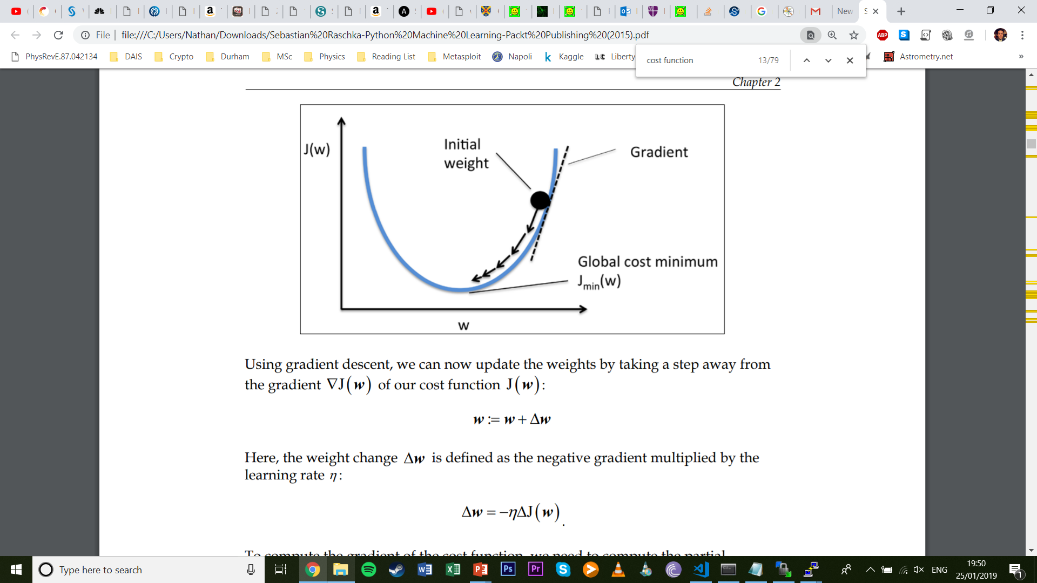
Learning the weights of the logistic cost function

Slide 19
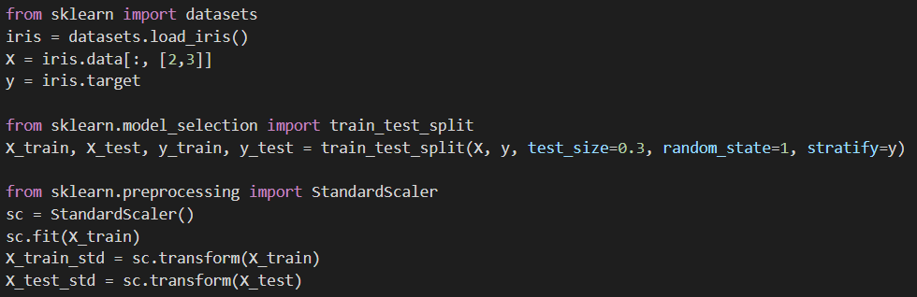
Training Logistic Regression with Scikit-Learn

Slide 20
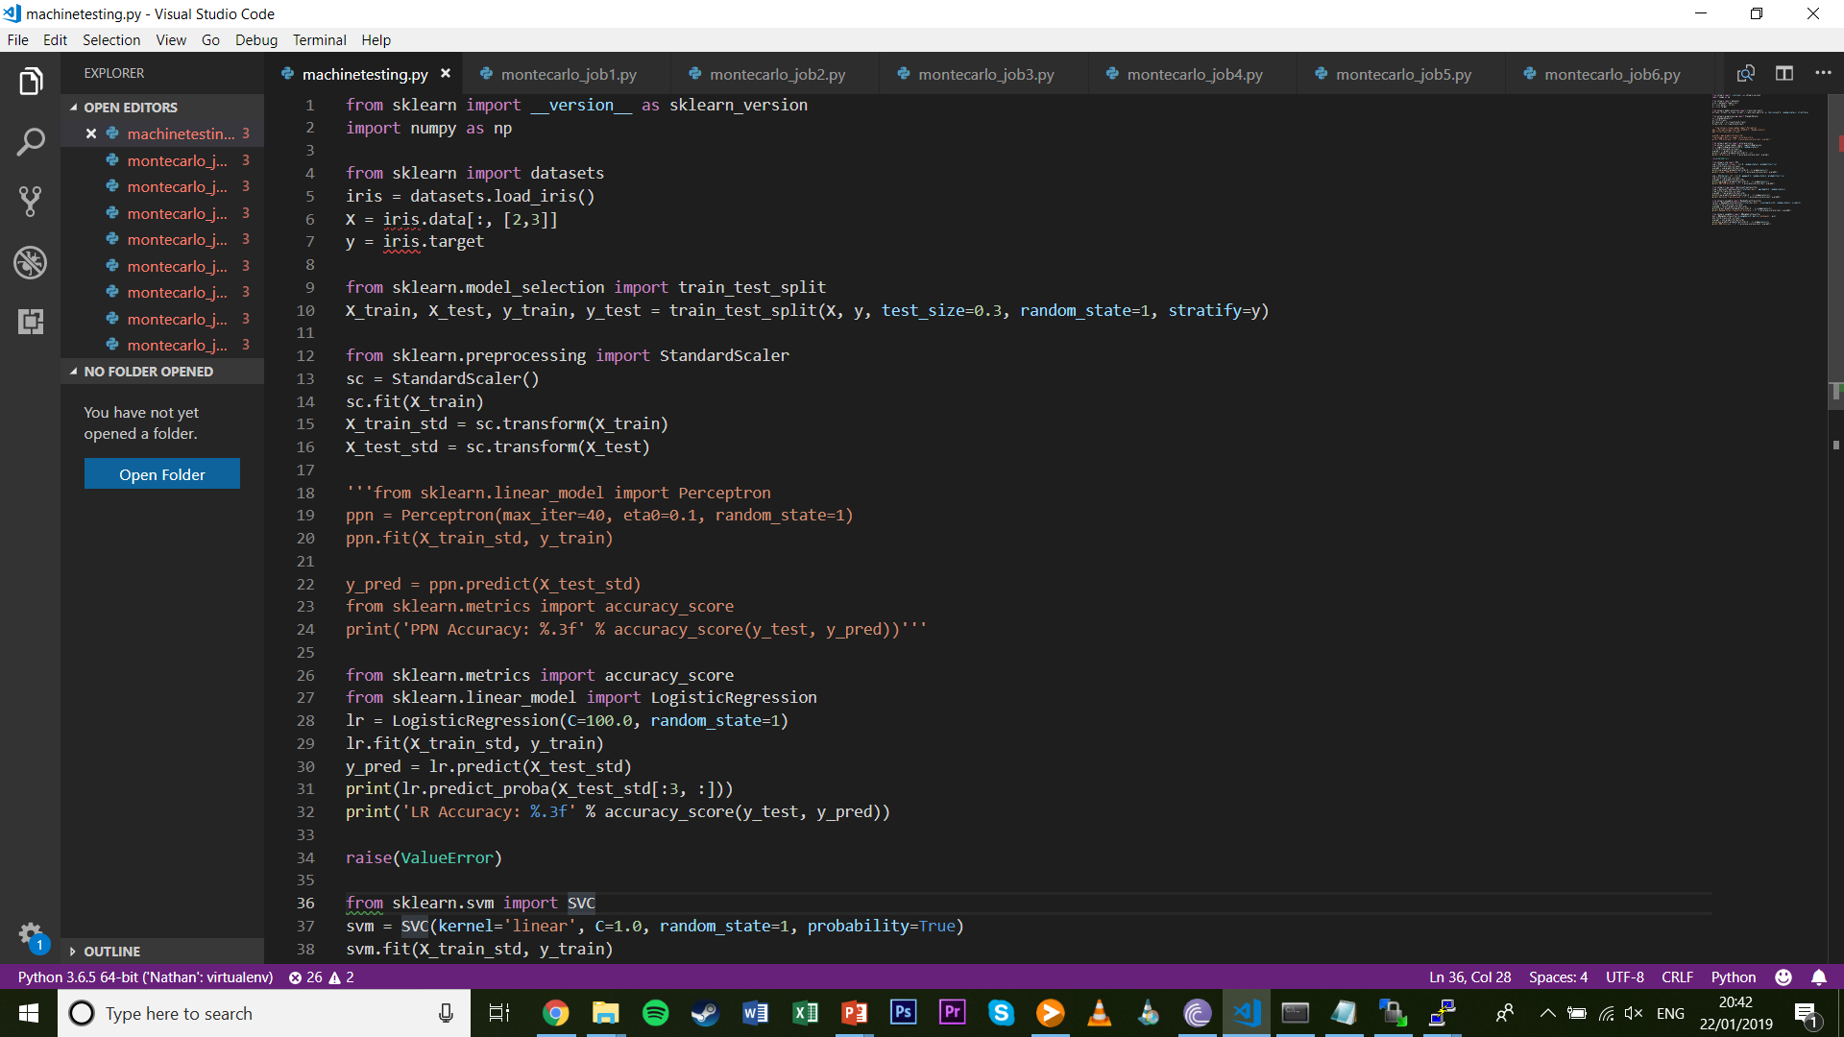
Training Logistic Regression with Scikit-Learn

Slide 21
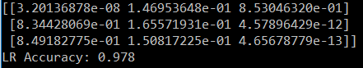
Training Logistic Regression with Scikit-Learn
Iris-virginica
Iris-setosa
Iris-versicolor
The arrays show the relative probabilities of each probability belonging to each of the three classes – note that they sum to 1
We also get the accuracy of the model across our entire test set – which comes out at an impressive 97.8%

Slide 22
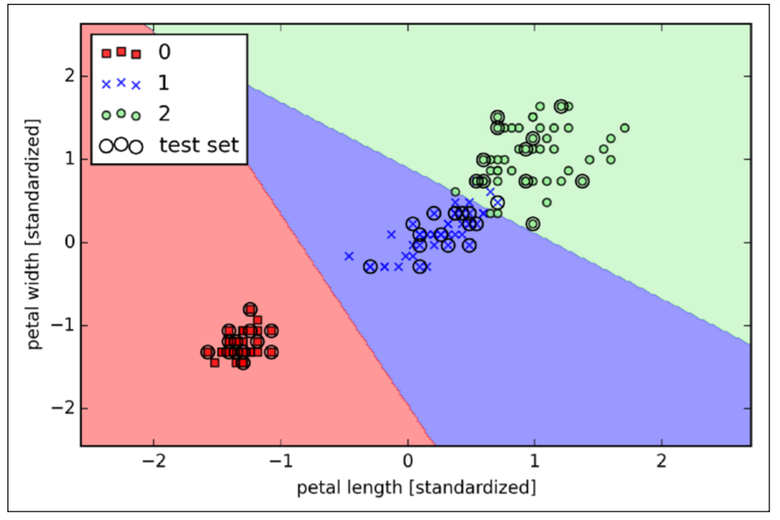
Training Logistic Regression with Scikit-Learn

Slide 23
Exercises
Q1: For data to be most effectively sorted by logistic regression, it has to be ________ separated?
Q2: Using trial and error, adjust the ‘C’ parameter in the Logistic Regression function to obtain a 100% prediction success rate

Slide 24
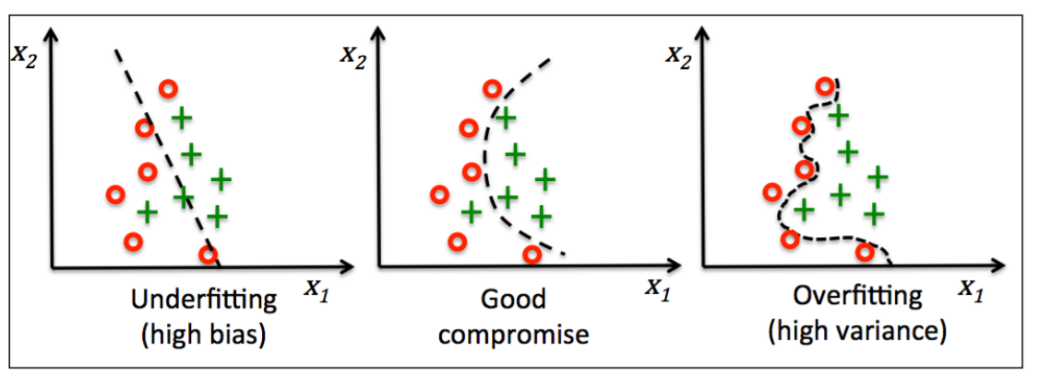
Tackling overfitting via regularisation
Overfitting is a common problem in Machine Learning, where a model performs well on training data but does not generalise well to unseen data
Similarly, models can suffer from underfitting which means the model is not complex enough to capture the training data’s patterns

Slide 25
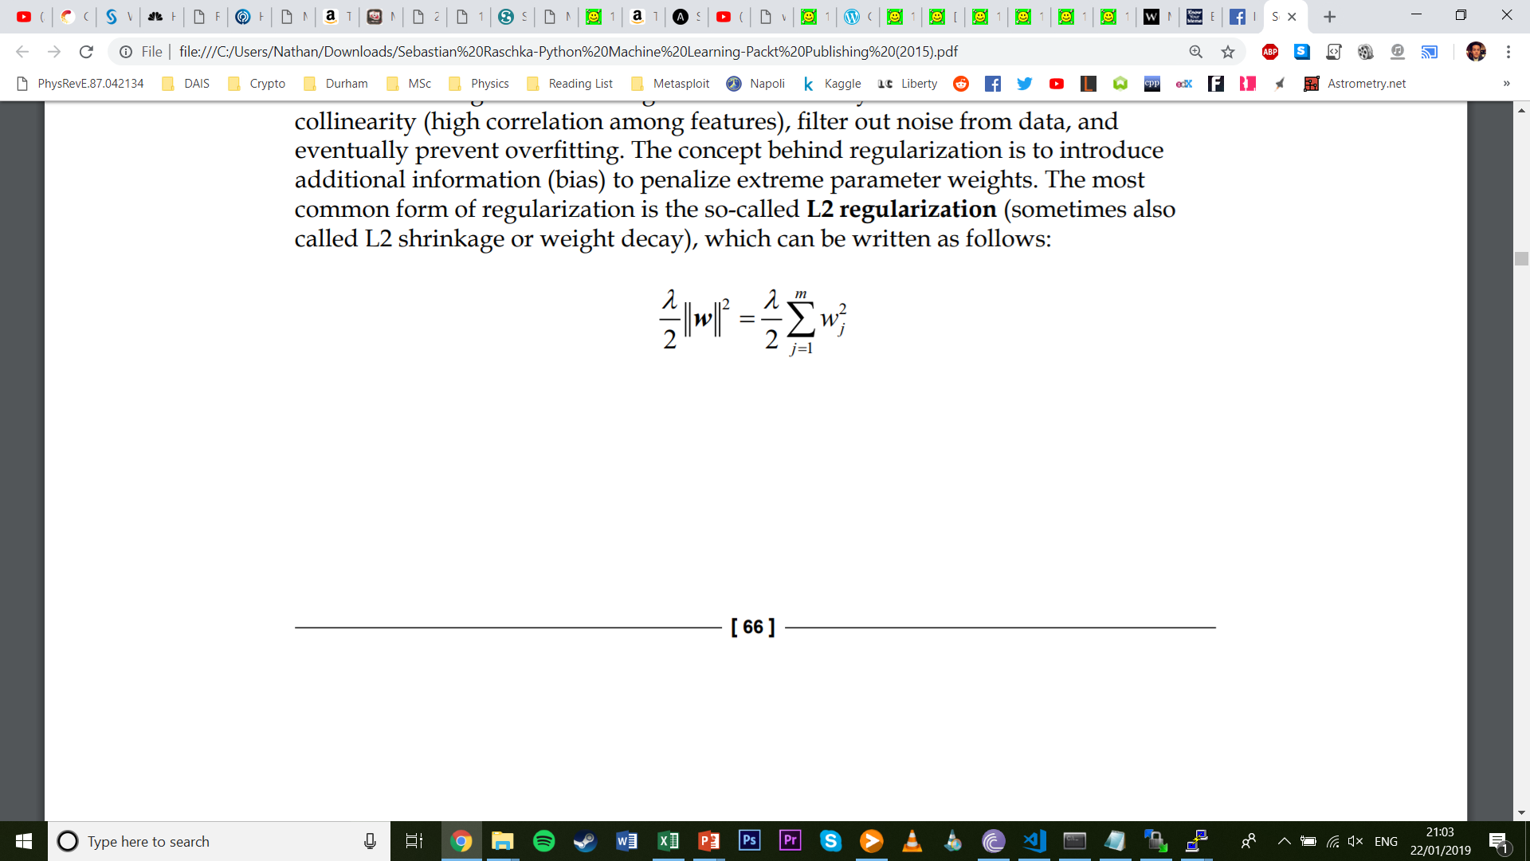
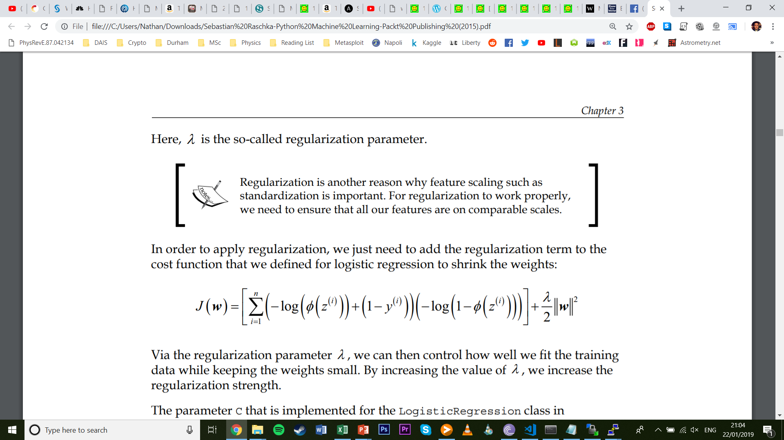
Tackling overfitting via regularisation
Regularization is a useful method to prevent overfitting
It involves introducing an additional term to the cost function that penalises extreme weight values

Slide 26
What is ‘C’?
It turns out that the ‘C’ parameter in our logistic regression function is the inverse of the regularization parameter λ
$$C=\frac{1}{\text{λ}}$$

Slide 27
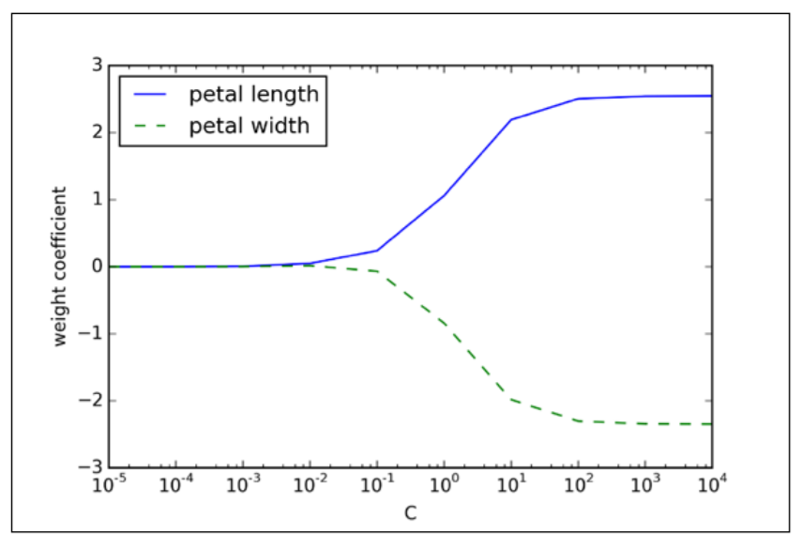
Tackling overfitting via regularisation

